Slide 1
Before you start
Download the IMP Test Instructions document and if you prefer print out the scoring sheets at the end
Download and read the IMPT TEST FAQ – a WORD file
Download IMPTEST.xls – an EXCEL file
Select Slide Show on the top menu and then ‘Play from Start’
Go to view and select ’Enter Full-Screen’
During phase 1 of the test use return or enter key to move on a screen
Hit return or enter and you are on your way…

Slide 2
IMP Test
© Bob Ryan 2016
Select Slideshow, Play from Start. Switch to full screen mode if possible. Only use the return key to advance the screens

Slide 3
Small But Important print
Unless you specifically agree otherwise, your response to the IMP test and the REI and my analysis of your results is confidential between us.
The REI and the IMP test are designed to help you identify your preferences for different ways of thinking and where you have strengths and weaknesses in your photographic skills. If you have any concerns about the analysis of your non-conscious patterns of thought you should not take the test.
My analysis of your results will be done impartially and fairly on the basis of the scores you give me. However, I cannot accept any liability resulting from the conduct of the test, downloading of files to your computer, the provision of the results or their interpretation.
In taking the test you agree that I may use your responses along with others for the purpose of research into the development of photographic skill and judgement. All data will be collected and analysed but individual test respondents will not be identifiable from the results.
You acknowledge that I am the sole copyright owner of the IMP test, its associated software and documentation. All rights to the IMP test, its associated software and documentation are reserved.

Slide 4
Introduction from Prof Bob
Hover pointer here for audio
Hit return to override or to proceed

Slide 5
What you need
A quiet and comfortable place with time to concentrate (the test takes about 40 minutes to complete).
The IMP instructions, which can be downloaded as a WORD file.
The assessment return as an EXCEL file called IMPTEST.xls. If preferred, the IMP instructions can be printed out and the attached input forms used to fill in the spreadsheet at the end of the test.
The final two tabs of IMPTEST.xls contain the Rational Experiential Inventory (REI) which is optional. You may find the results useful when interpreting the output from the IMP test.

Slide 6
phase 1
The downloaded spreadsheet has a number of tabs – IMPTAB1 is for your personal details.
IMPTAB2, is the input screen for the first phase of the test.
You are invited to assess each image on a 0 – 100 scale. The first five images are there to help you start. We suggest a score of 60 for the first image you see.
You will then go through the 20 test images scoring them as you see fit.
Each image is visible for 3 second only. Once you have recorded your score hit return to move on to the next image.
VERY IMPORTANT: ONCE YOU HAVE COMPLETED ALL 25 IMAGES DO NOT REFER BACK TO IMPTAB2 OR TO YOUR HAND-WRITTEN COPY AS YOU DO THE LATTER PHASES OF THE TEST.
Use the return key to step through the images.

Slide 7
Image 1
Use the return key

Slide 9
What number from 0 – 100 first came into your mind when you saw image 1?
Say that number out loud, write it down on your scoring sheet
or enter it directly into IMPTAB2.
Do not change that number.
Do not back-track during this phase of the test.
Use the return key

Slide 10
Image 2
Use the return key

Slide 12
Image 3
Use the return key

Slide 14
Image 4
Use the return key

Slide 15
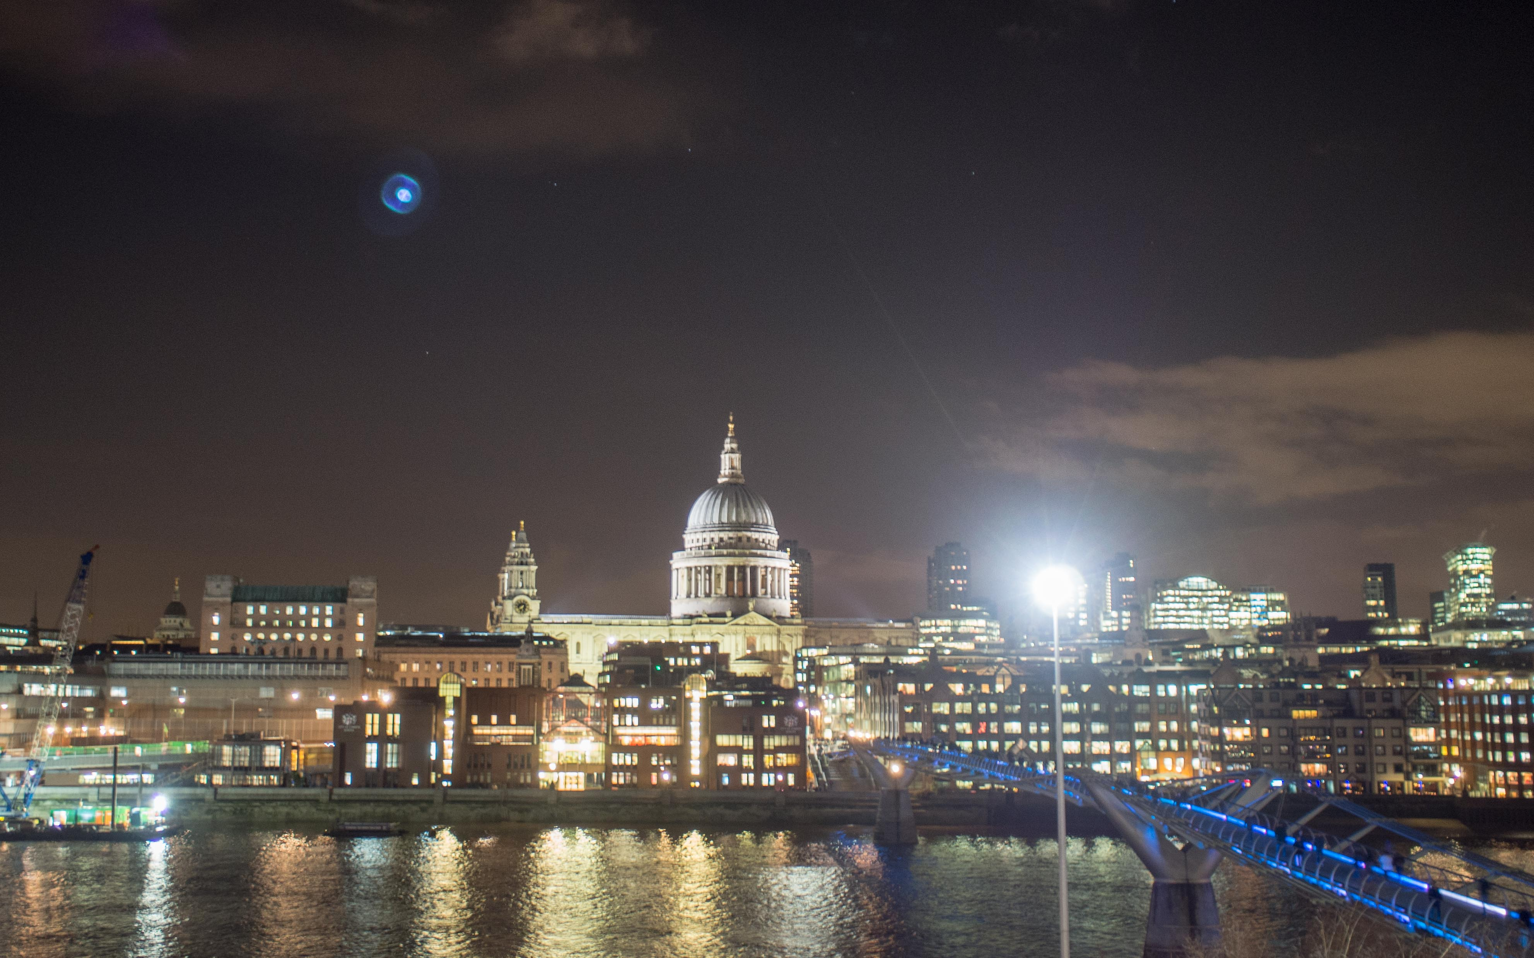

Slide 16
Image 5
Use the return key

Slide 17
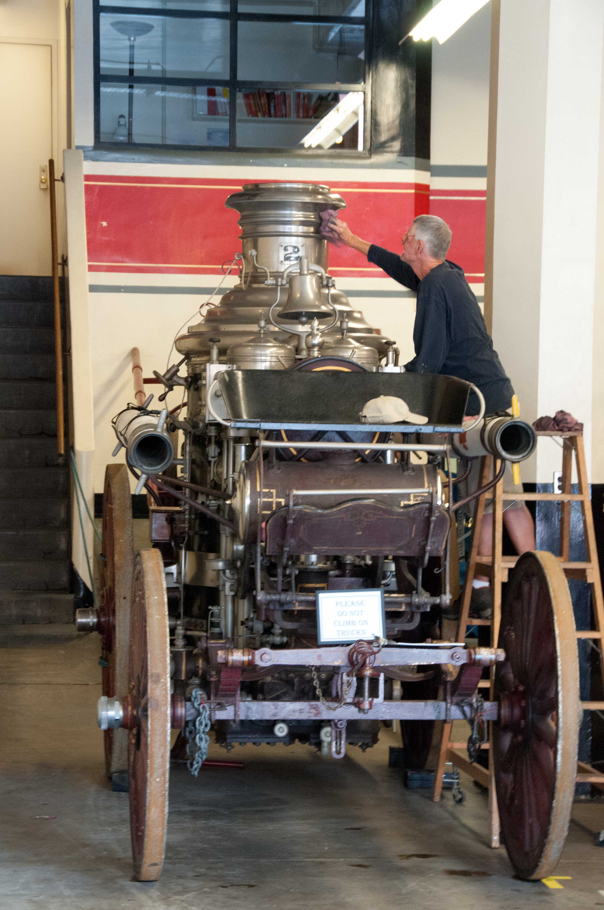

Slide 18
Image 6
Use the return key

Slide 20
Image 7
Use the return key

Slide 22
Image 8
Use the return key

Slide 24
Image 9
Use the return key

Slide 26
Image 10
Use the return key

Slide 28
Image 11
Use the return key

Slide 30
Image 12
Use the return key

Slide 32
Image 13
Use the return key

Slide 34
Image 14
Use the return key

Slide 36
Image 15
Use the return key

Slide 37
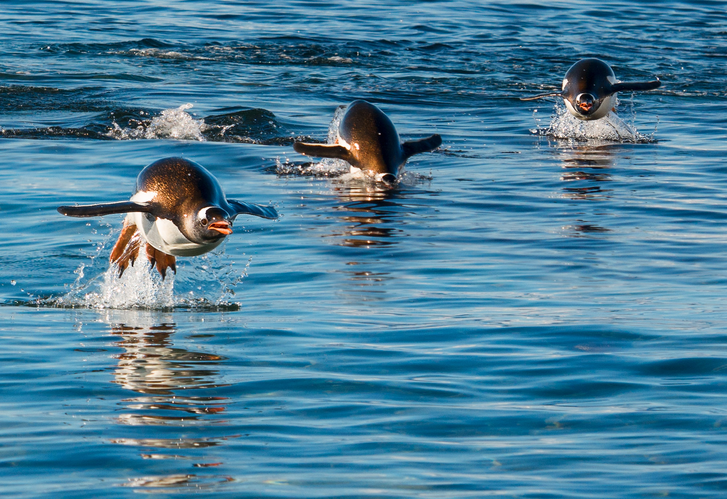

Slide 38
Image 16
Use the return key

Slide 40
Image 17
Use the return key

Slide 42
Image 18
Use the return key

Slide 44
Image 19
Use the return key

Slide 46
Image 20
Use the return key

Slide 47
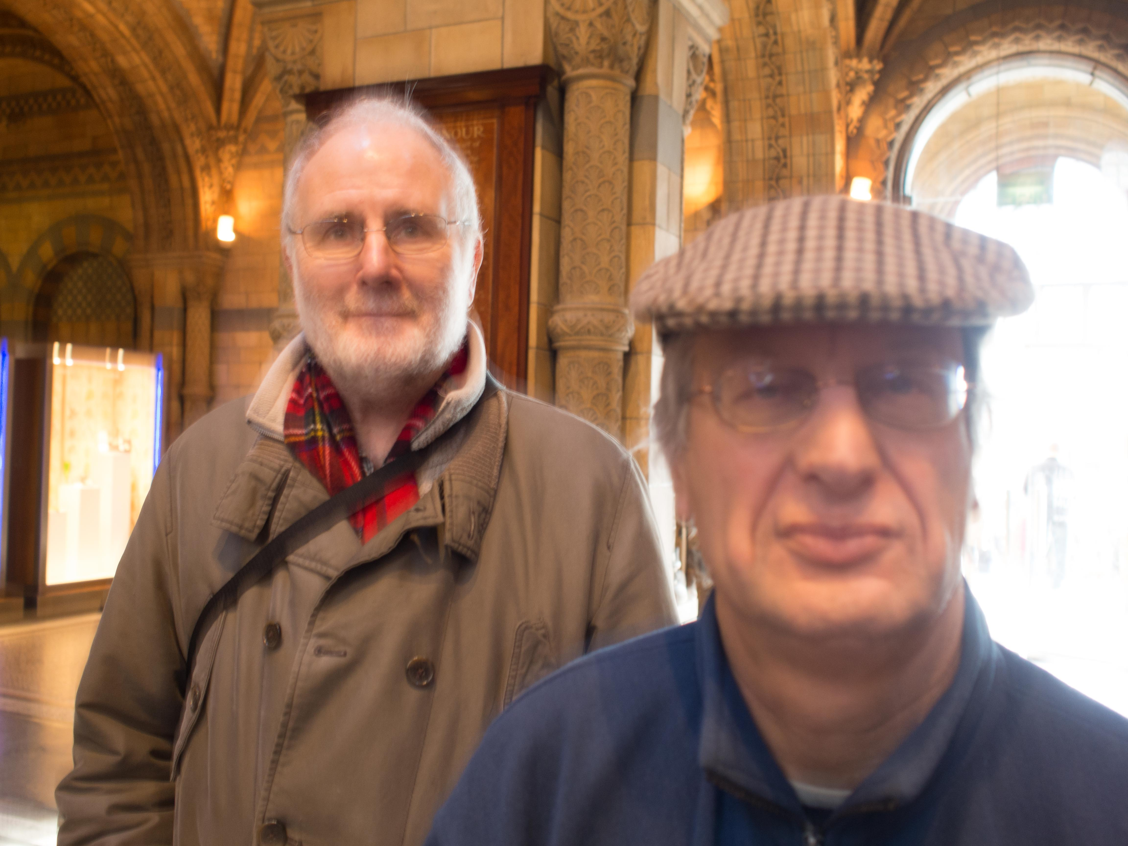

Slide 48
Image 21
Use the return key

Slide 50
Image 22
Use the return key

Slide 52
Image 23
Use the return key

Slide 54
Image 24
Use the return key

Slide 56
Image 25
Use the return key

Slide 58
Well done – that’s the end of the first phase of the test.

Slide 59
Phase 2
Now
Don’t look back at your Phase 1 results
On the printed form or on IMPTAB3 enter your importance score against each judgement construct using the ten sliders. You can give the same importance score to two or more constructs if you think that is appropriate.
On the next slide we show you the 10 constructs.
Bob Ryan on the 10 constructs

Slide 60
The Ten constructs
Use the return key

Slide 61
PHASE 3
Using IMPTAB4 or your printed form score images 6 – 25 against each of the ten photographic constructs.
Don’t look back at your phase 1 scores.
For each image score it, against each criterion, on a scale of 1 – 10 using whole numbers only.
Take as long as you like over this stage of the test.

Slide 62
Image 6
Use the return key

Slide 64
Image 7
Use the return key

Slide 66
Image 8
Use the return key

Slide 68
Image 9
Use the return key

Slide 70
Image 10
Use the return key

Slide 72
Image 11
Use the return key

Slide 74
Image 12
Use the return key

Slide 76
Image 13
Use the return key

Slide 78
Image 14
Use the return key

Slide 80
Image 15
Use the return key

Slide 82
Image 16
Use the return key

Slide 84
Image 17
Use the return key

Slide 86
Image 18
Use the return key

Slide 88
Image 19
Use the return key

Slide 90
Image 20
Use the return key

Slide 92
Image 21
Use the return key

Slide 94
Image 22
Use the return key

Slide 96
Image 23
Use the return key

Slide 98
Image 24
Use the return key

Slide 100
Image 25
Use the return key

Slide 102
That’s the end of the IMPtest
DON’T CHANGE ANY OF YOUR SCORES
If you have written your scores on a printed version enter them into the respective tabs on the IMPTEST spreadsheet.
Now is the time to do the optional Rational Experiential Inventory filling in the answers on REI Input. Your scores are shown on REI Output as you complete the inventory.
Check all tabs are complete.
Save your copy of your completed test with a unique file name in the form yournameIMPTESTreturn and upload that copy as instructed on our website or send it to me at professorbobryan@btinternet.com.

